Slide 1

The new face of learning
Anant Agarwal
edX

Slide 2
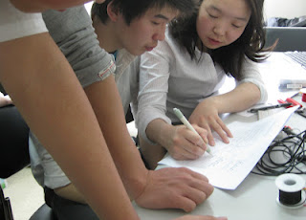
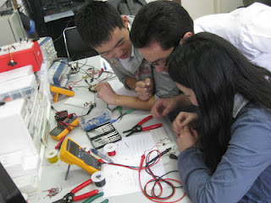

6002x.blogspot.com – the new classroom
Where is this?

Slide 3
Joint venture of Harvard and MIT
Open source platform
Portal for learning
Production support
Harvard → HarvardX
MIT → MITx
U3 → U3x

Slide 4
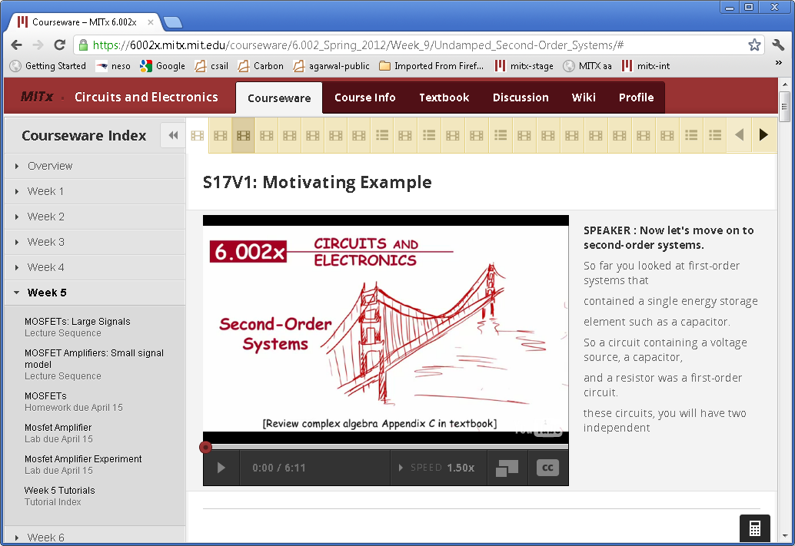
Textbook
Discussion

Slide 10
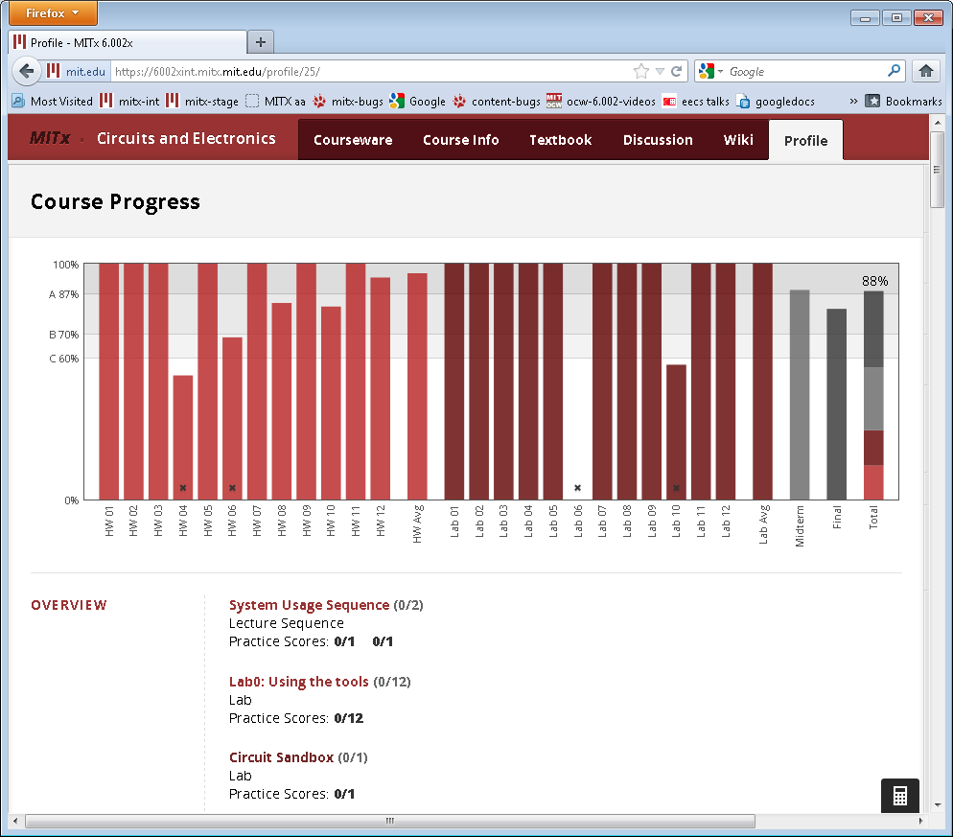

Slide 11
Of course, it’s not all business
(it’s Rana)

Slide 12
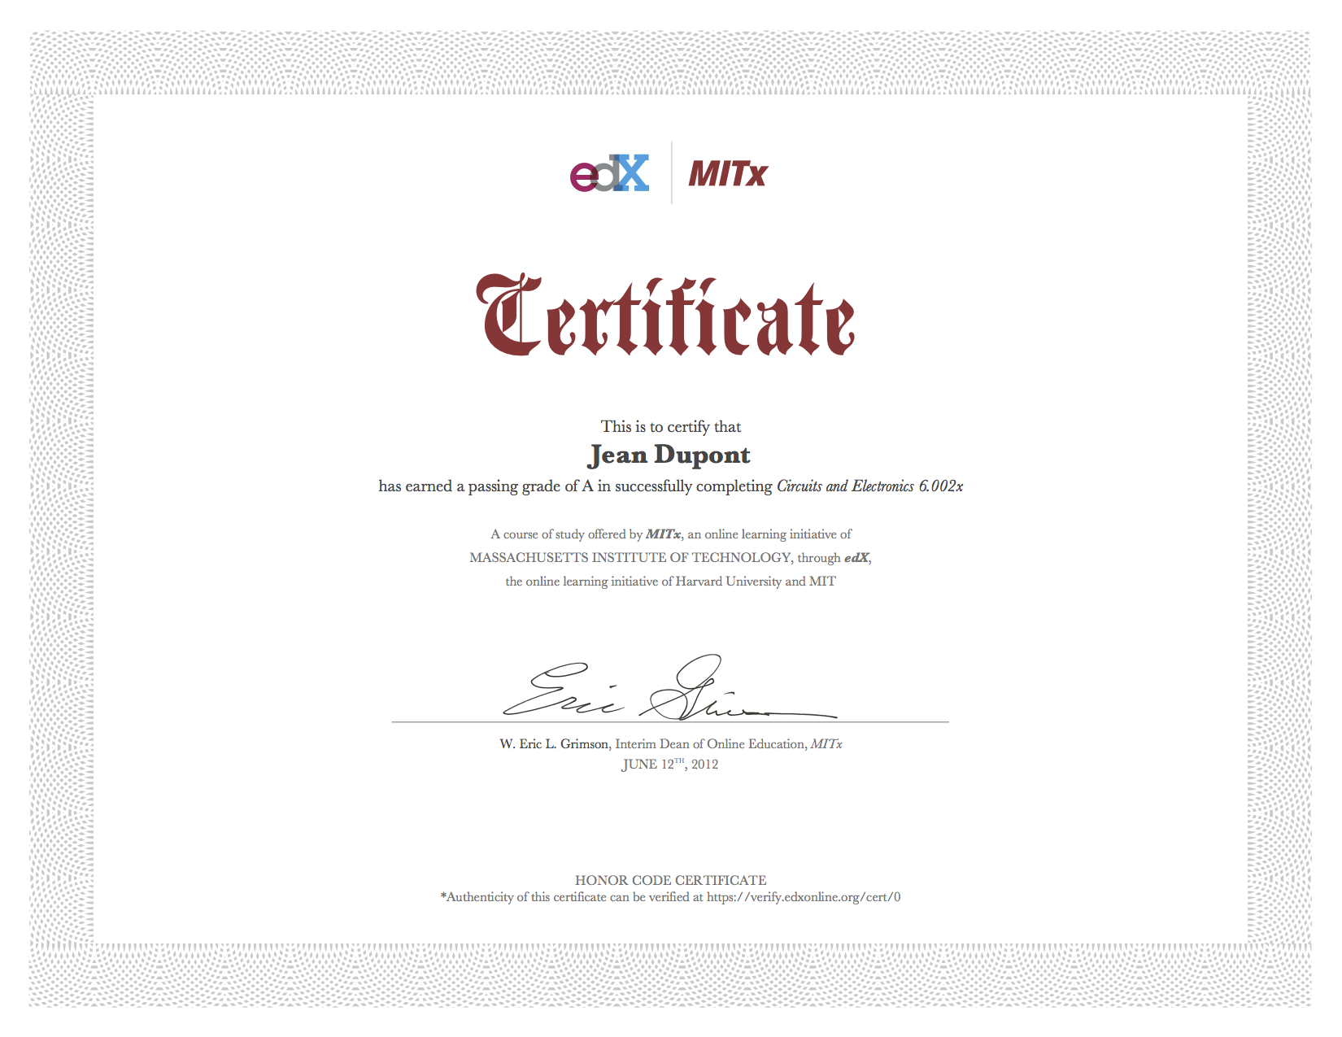

Slide 13
“This course was the most rewarding experience of my life.”
-Student, Pakistan

Slide 14
Flips the “funnel”

Slide 15

Admitted: ~1600
Applied to MIT’s Class of 2015: ~18,000

Slide 16
Certified
Took the Final
Passed the Midterm
Made it to the Midterm
Tried the First Problem Set
Registered for 6.002x: Circuits and Electronics

Slide 17
Page Load Times by Country
Learners from all over the world
USA: 2.9sec
30% of Traffic
Liberia: 21.3sec
<1% of Traffic
India: 6.2sec
13% of Traffic

Slide 18
Traffic by Country
Who is #4?

Slide 19
What We Learned/Surprises

Slide 20
Online Students Have Something in Common with Residential Ones…
Procrastination

Slide 21
An edX Cult Symbol?
Real-time feedback is a game changer

Slide 22
We’re Learning More Every Day
6.002x students preferred handwritten videos to typeset PowerPoint slides by a 4:1 ratio
And they preferred typeset reference materials by more than 2:1
Typeset vs. handwritten video comparison
by Mydhili Bayyapunedi and team, Microsoft

Slide 23
What We Learned/Surprises
Discussion forum scales, and is huge learning tool
  Learning by teaching
  Forming communities
  Students want to continue in the same community (students want 6.004x next, which is natural follow-on to 6.002x)
  Students value education highly and extraordinarily grateful
Online textbooks from publishers may not be as hard as we think
Most MIT students watch lectures at 1.5X speed, and read transcription

Slide 24
Online Learning can Reinvent
Campus Education
Think about this: Online class is good as is. On-campus and instructors and TAs have 20-25 hours per week. Can be creative!
Labs and field trips with students
Group problem solving
Project oriented classes
Personalized learning

Slide 25
“MITx may have saved our marriage.”
-Mother of two, taking the course with her husband
“Awww, you guys are having
a pset date!”
-Her daughter, MIT ‘15, Course 6
Notes:
Context: A 50yr old stay at home mom (BSE) and her husband (BSEE) took the course. It Their daughter is MIT ’15, course 6.

